Slide 1

Econometrics and Statistical Models Project
Louise Dietrich - Alberto Monari - Kevin Da Silva
Predictive model & linear regression

Slide 2

Objective
Our dataset is made of 395 observations of students from two Portuguese schools.
Our main objective is to create a predictive model able to predict the final grade of a student, based on the different variables recorded.
In order to do that we will run a multiple linear regression model.

Slide 3




Road Map
Cleaning data
There is no missing value in the data set. We have to change the format of some variables as factor to start our study.
Findings -> Insights
We removed every attribute that was not relevant in the prediction of the final grade.
We are left with 5 different variables,
2 with a positive correlation to the final grade:
The student gender if it is male
The mother’s level of education
3 with a negative correlation:
The number of past class failures
If the student is in a romantic relationship
If the student goes out with friends
Those 5 variables explain 17,02% of our prediction model, in a confidence interval of 95%.
Methodology
We will perform multiple linear regressions to determine the influent factors on the student’s final grade.
Business question
Which factors have an influence on the final grade of the students and how can we maximize it ?
Data
The original dataset presents 395 observations of students with 33 different attributes, including grades, some of their habits and social-economic situation characteristics.
Context
The Portuguese Ministry of Education has decided to collect students data from 2 Portuguese schools to try to better understand the factors influencing students' final grades in Portugal.
Intuition -> Hypothesis
We sorted each variable to the corresponding impact we think it might have on students’ performance:
Positive Impact | No Significant Impact | Negative Impact
Medu, Fedu, studytime, schoolsup, famsup, paid, higher, internet, health | School, sex, age, famsize, Pstatus, Mjob, Fjob, reason, guardian, activities, nursery,romantic, famrel, freetime | Traveltime, failures, gout, Dalc, Walc, absences
Recommendations
The education professionals should look into the gender gap in the final grades (10,91/20 on average for male and 9,97/20 for female students) to ensure equality at school.
They could also prevent the negative correlation of the social life of the students on its results (having a romantic relationship or going out with friends) by giving insights on how to combine studies and personal life.
Stakeholders
With the study of this dataset, education professionals and student parents will be able to influence the students results by minimizing factors having a negative impact, and strengthening the ones improving the final grade.
Name of the variables explicited in Data Description
Analysis goals
The purpose of this analysis is to model the attribution of final grades to the students, in order to predict their results or to know what factors could improve their final year grade.

Slide 4
Data source
Provided by the UCI Machine Learning Repository
https://archive.ics.uci.edu/ml/datasets/Student+Performance
Data collected by P. Cortez & A. Silva, 2005-2006, Porto (Portugal), EUROSIS

Slide 5
Data Description
The dataset presents information of 395 students from two Portuguese schools.
It gathers observations of :
different habits, such as their alcohol consumption or their number of hours studied
socioeconomic factors, such as their parents’ education, profession,…
their grades for the first & second period, and grades of the final exam
We have chosen 30 independant variables (all the variables except G1, G2, G3) as predictors to start our model : 17 categorial variables (factors), and 13 quantitative variables.
The dependant variable is G3.
1 school - student's school (binary: "GP" - Gabriel Pereira or "MS" - Mousinho da Silveira)
2 sex - student's sex (binary: "F" - female or "M" - male)
3 age - student's age (numeric: from 15 to 22)
4 address - student's home address type (binary: "U" - urban or "R" - rural)
5 famsize - family size (binary: "LE3" - less or equal to 3 or "GT3" - greater than 3)
6 Pstatus - parent's cohabitation status (binary: "T" - living together or "A" - apart)
7 Medu - mother's education (numeric: 0 - none, 1 - primary education (4th grade), 2 – 5th to 9th grade, 3 – secondary education or 4 – higher education)
8 Fedu - father's education (numeric: 0 - none, 1 - primary education (4th grade), 2 – 5th to 9th grade, 3 – secondary education or 4 – higher education)
9 Mjob - mother's job (nominal: "teacher", "health" care related, civil "services" (e.g. administrative or police), "at_home" or "other")
10 Fjob - father's job (nominal: "teacher", "health" care related, civil "services" (e.g. administrative or police), "at_home" or "other")
11 reason - reason to choose this school (nominal: close to "home", school "reputation", "course" preference or "other")
12 guardian - student's guardian (nominal: "mother", "father" or "other")
13 traveltime - home to school travel time (numeric: 1 - <15 min., 2 - 15 to 30 min., 3 - 30 min. to 1 hour, or 4 - >1 hour)
14 studytime - weekly study time (numeric: 1 - <2 hours, 2 - 2 to 5 hours, 3 - 5 to 10 hours, or 4 - >10 hours)
15 failures - number of past class failures (numeric: n if 1<=n<3, else 4)
16 schoolsup - extra educational support (binary: yes or no)
17 famsup - family educational support (binary: yes or no)
18 paid - extra paid classes within the course subject (Math or Portuguese) (binary: yes or no)
19 activities - extra-curricular activities (binary: yes or no)
20 nursery - attended nursery school (binary: yes or no)
21 higher - wants to take higher education (binary: yes or no)
22 internet - Internet access at home (binary: yes or no)
23 romantic - with a romantic relationship (binary: yes or no)
24 famrel - quality of family relationships (numeric: from 1 - very bad to 5 - excellent)
25 freetime - free time after school (numeric: from 1 - very low to 5 - very high)
26 goout - going out with friends (numeric: from 1 - very low to 5 - very high)
27 Dalc - workday alcohol consumption (numeric: from 1 - very low to 5 - very high)
28 Walc - weekend alcohol consumption (numeric: from 1 - very low to 5 - very high)
29 health - current health status (numeric: from 1 - very bad to 5 - very good)
30 absences - number of school absences (numeric: from 0 to 93)
31 G1 - first period grade (numeric: from 0 to 20)
31 G2 - second period grade (numeric: from 0 to 20)
32 G3 - final grade (numeric: from 0 to 20, output target)

Slide 6
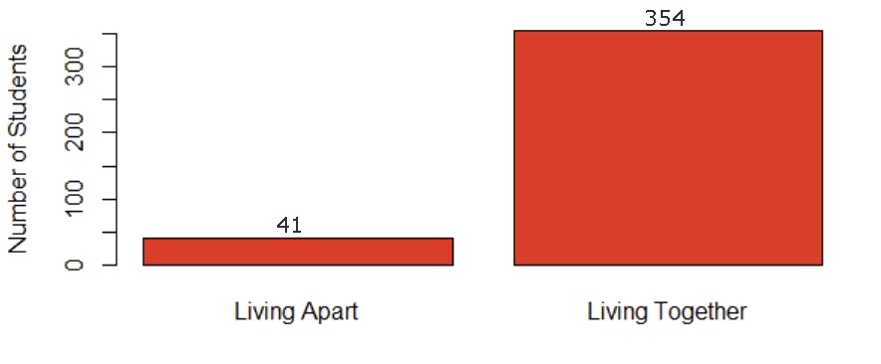
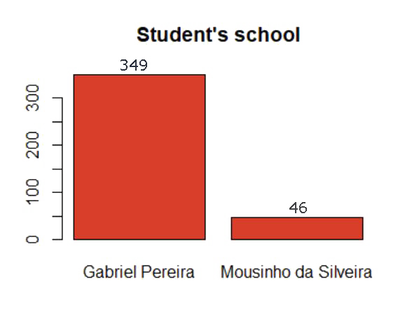
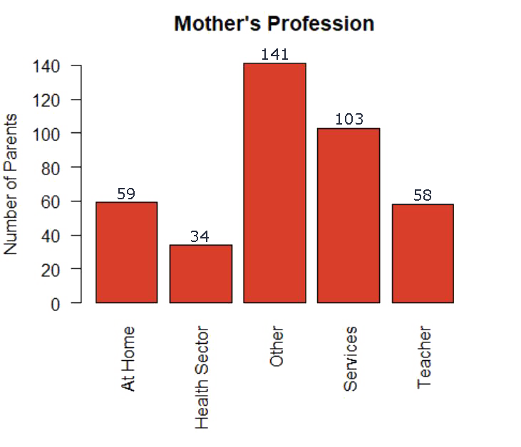
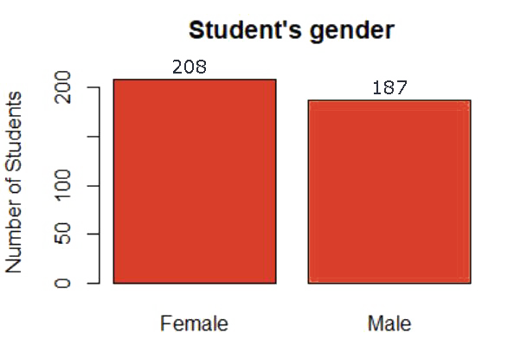
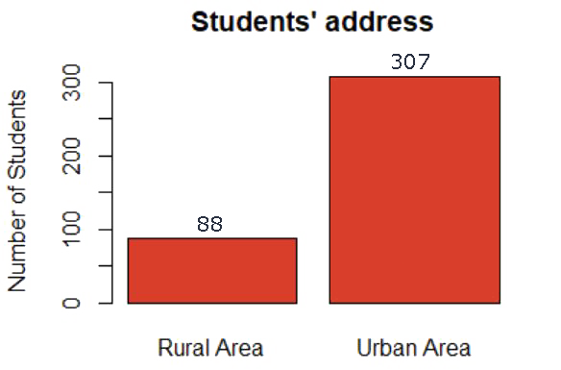
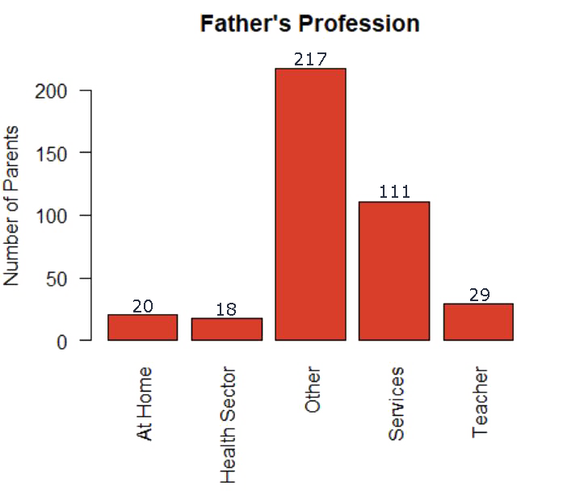
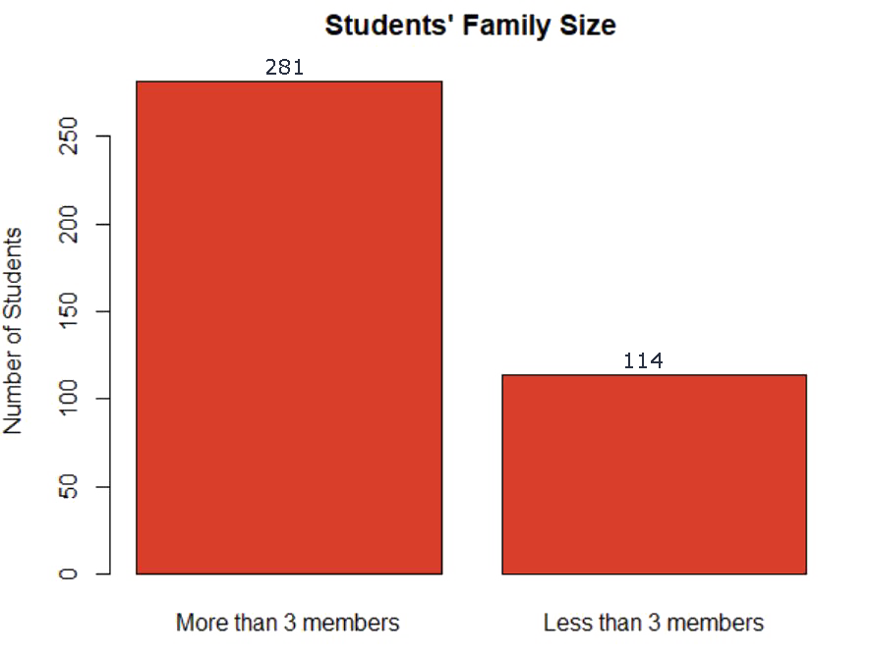
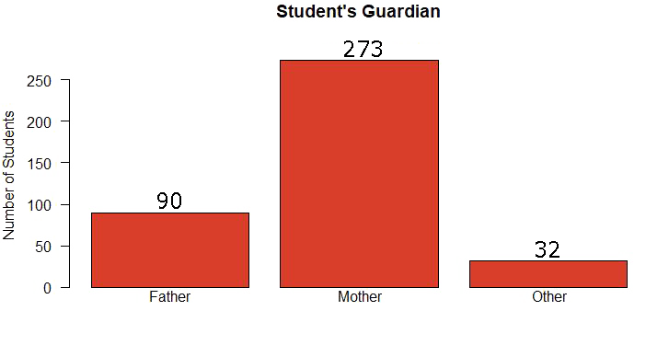
Exploratory analysis
Categorial Variables
Pstatus factor | Parents cohabitation status 2 levels: living apart or together
Mjob factor | Mother’s professional occupation 5 levels: at home, health sector, services, teacher, other
Fjob factor | Father’s professional occupation 5 levels: at home, health sector, services, teacher, other)
guardian factor | Guardian 3 levels: father, mother, other
school factor | School attended 2 levels : Gabriel Pereira or Mousinho da Silveira
sex factor | Gender 2 levels: M or F
address factor | Home address type 2 levels: rural of urban
famsize factor | Family’s size 2 levels: more or less than 3 members

Slide 7
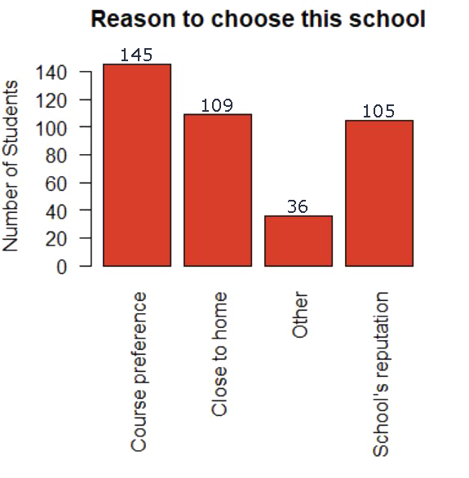
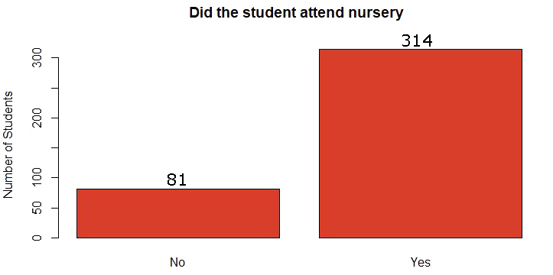
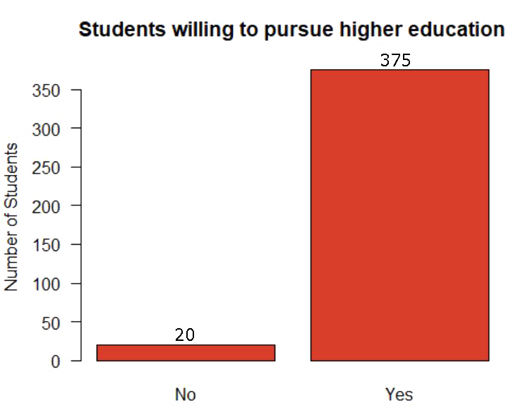
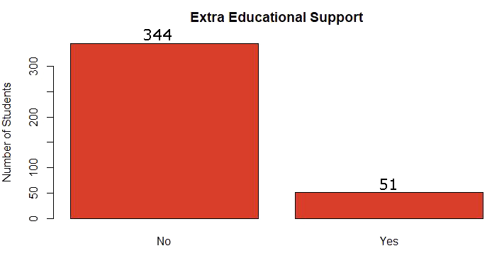
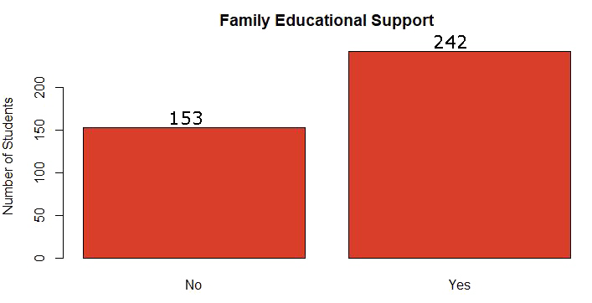
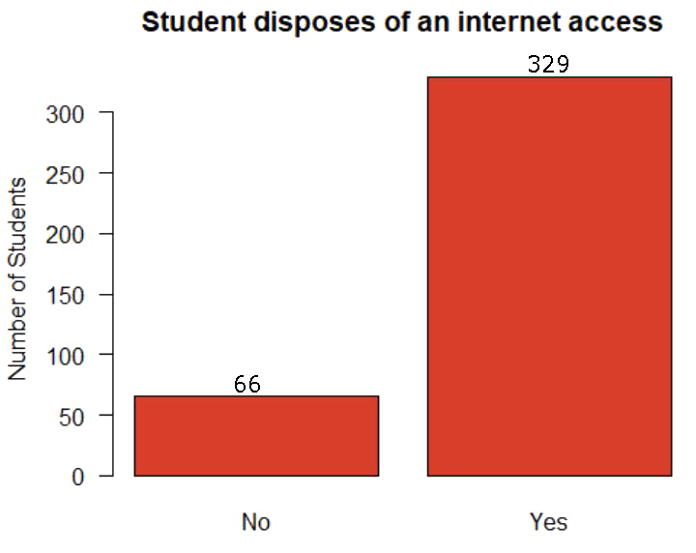
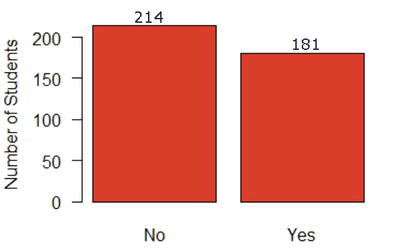
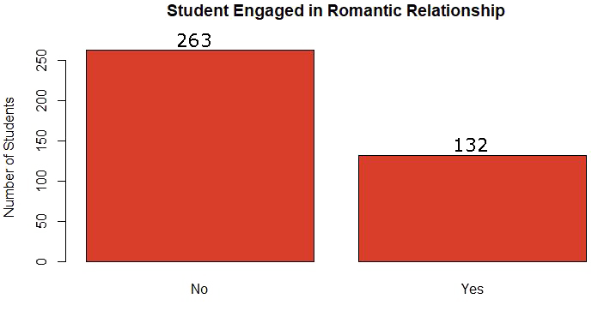
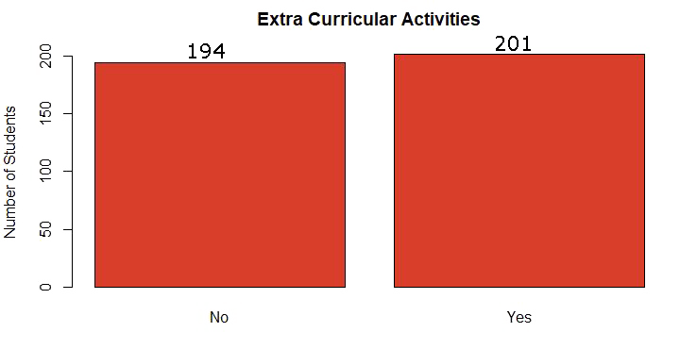
Exploratory analysis
reason factor | Reason to chose that school 4 levels: Course preference, close to home, school’s reputation, other
schoolsup factor | Extra educational support 2 levels: yes / no
Famsup factor | Family educational support 2 levels: yes/no
paid factor | Following of extra paid classes 2 levels: yes/no
activities factor | Extra-curricular activities 2 levels: yes/no
nursery factor | Attended the nursery school 2 levels: yes/no
higher factor | Intention to take higher education 2 levels: yes/no
internet factor | Internet connection at home 2 levels: yes/no
romantic factor | In romantic relationship 2 levels: yes/no

Slide 8
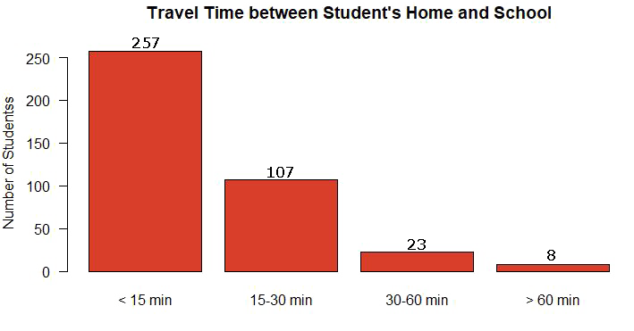
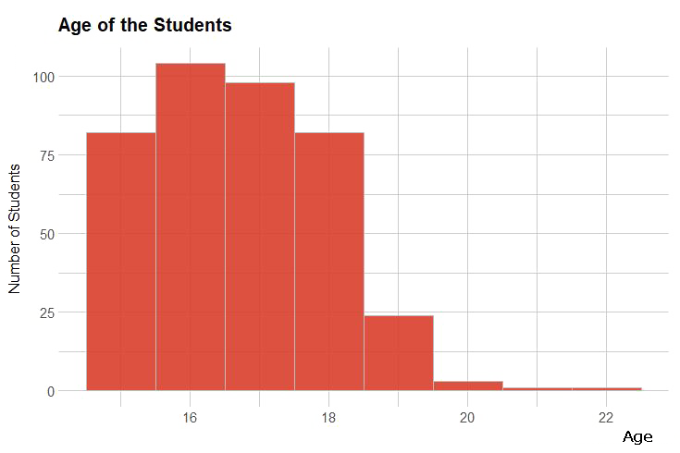
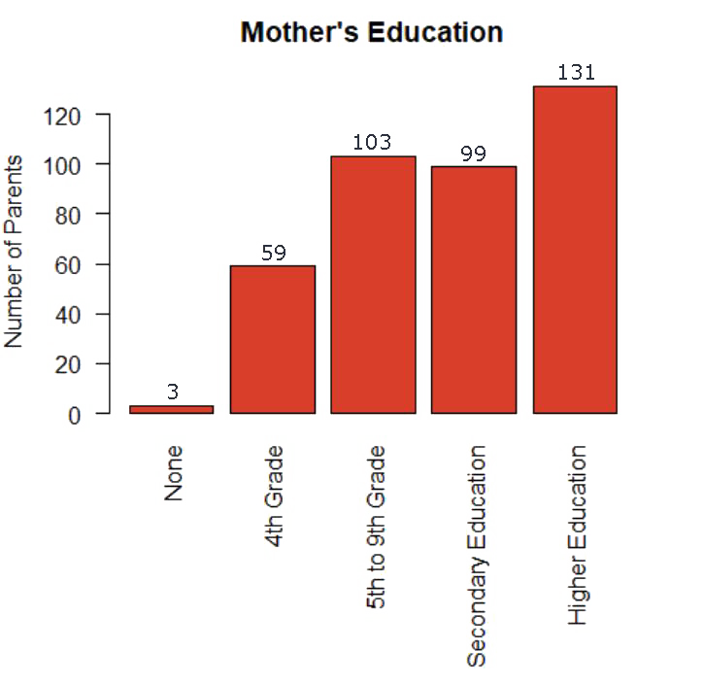
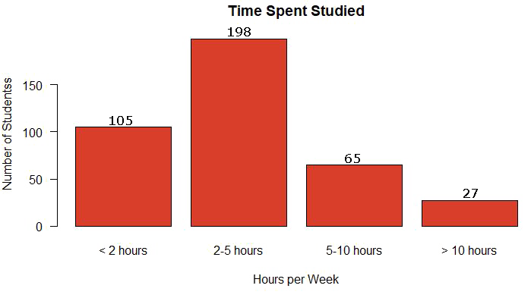
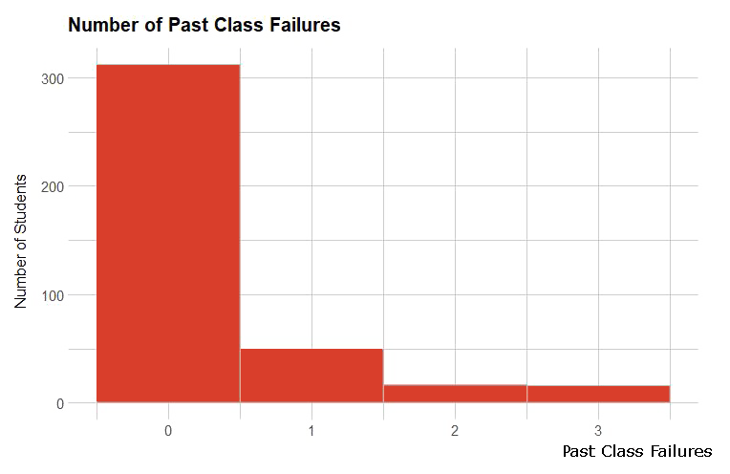
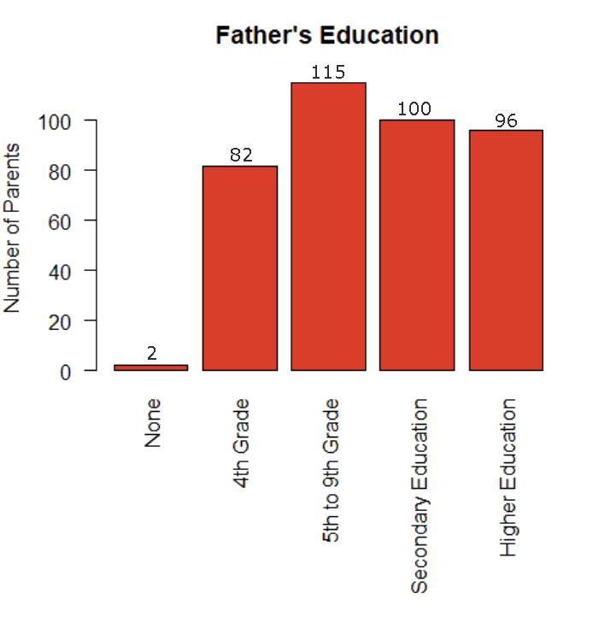
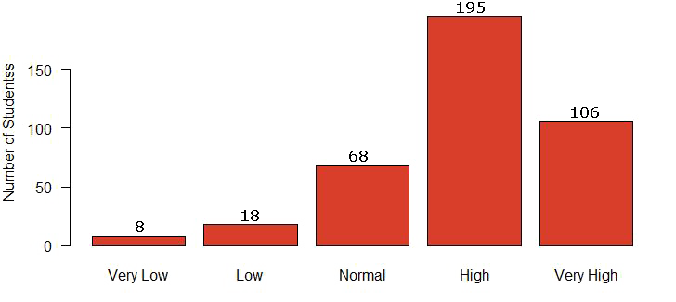
Exploratory analysis
Quantitative Variables
traveltime integer | Home to school time travel Values: 1 - <15 min 2- 15-30 min 3- 30-60 min 4- >60 min
studytime integer | Weekly study time Values: 1 - <2 hours 2- 2 to 5 hours 3- 5 to 10 hours 4- >10 hours
failures integer | Number of past class failures
famrel integer | Quality of the family relationship From 1 – very bad to 5 – excellent
age interger | Age
Medu integer | Mother’s education Values: 0 - none, 1 - primary education (4th grade), 2 - 5th to 9th grade, 3 - secondary education 4 - higher education
Fedu integer | Father’s education Values: 0 - none, 1 - primary education (4th grade), 2 - 5th to 9th grade, 3 - secondary education 4 - higher education

Slide 9
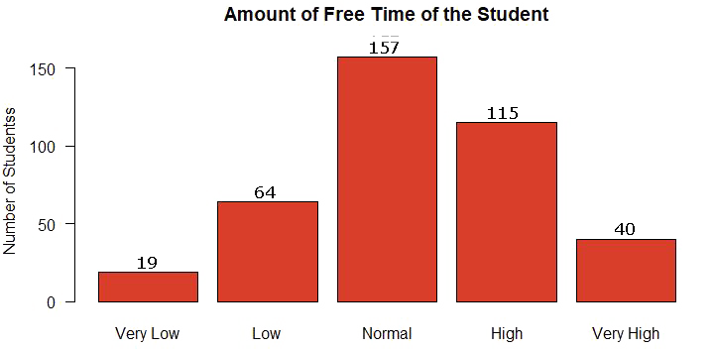
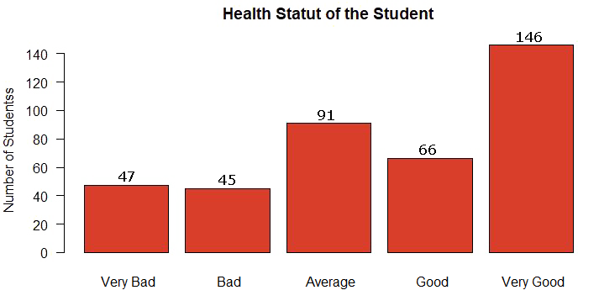
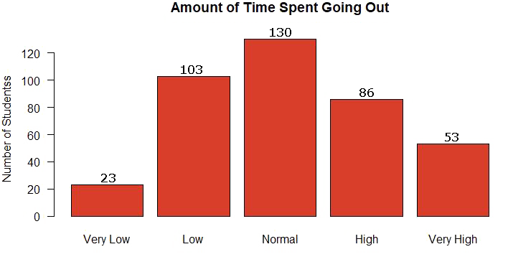
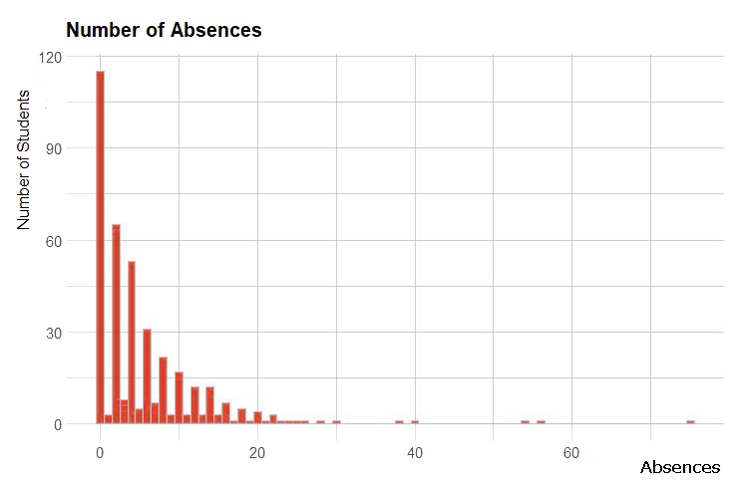
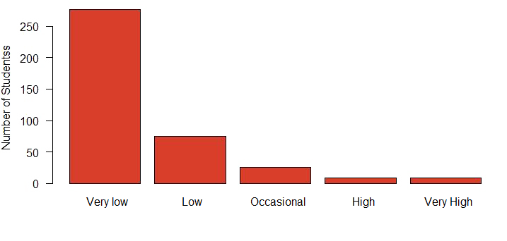
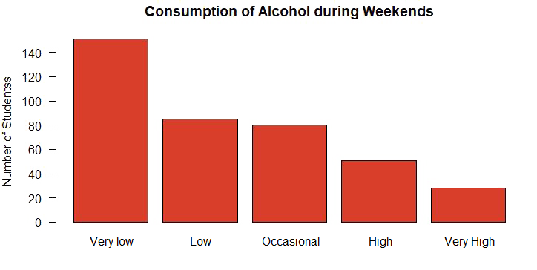
Exploratory analysis
freetime Interger | Free time after school From 1– very low to 5– very high
goout integer | Amount of time spent going out with friends From 1– very low to 5– very high
Dalc Integer | Workday alcohol consumption From 1– very low to 5– very high
Walc integer | Weekend alcohol consumption From 1– very low to 5– very high
health integer | Current health status From 1- very bad to 5- very good
absences integer | Number of school absences
> summary(student_data$absences)
Min. 1st Qu. Median Mean 3rd Qu. Max.
0.000 0.000 4.000 5.709 8.000 75.000

Slide 10
Data Cleaning
Firstly we checked the structure and we had to change the format of different variables from character to factor to explicitly express the levels represented by those variables.
> str(student_data)
'data.frame': 395 obs. of 33 variables:
$ school : chr "GP" "GP" "GP" "GP" ...
$ sex : chr "F" "F" "F" "F" ...
$ age : int 18 17 15 15 16 16 16 17 15 15 ...
$ address : chr "U" "U" "U" "U" ...
$ famsize : chr "GT3" "GT3" "LE3" "GT3" ...
$ Pstatus : chr "A" "T" "T" "T" ...
$ Medu : int 4 1 1 4 3 4 2 4 3 3 ...
$ Fedu : int 4 1 1 2 3 3 2 4 2 4 ...
$ Mjob : chr "at_home" "at_home" "at_home" "health" ...
> str(student_data)
'data.frame': 395 obs. of 33 variables:
$ school : Factor w/ 2 levels "GP","MS": 1 1 1 1 1 1 1 1 1 1 ...
$ sex : Factor w/ 2 levels "F","M": 1 1 1 1 1 2 2 1 2 2 ...
$ age : int 18 17 15 15 16 16 16 17 15 15 ...
$ address : Factor w/ 2 levels "R","U": 2 2 2 2 2 2 2 2 2 2 ...
$ famsize : Factor w/ 2 levels "GT3","LE3": 1 1 2 1 1 2 2 1 2 1 ...
$ Pstatus : Factor w/ 2 levels "A","T": 1 2 2 2 2 2 2 1 1 2 ...
$ Medu : int 4 1 1 4 3 4 2 4 3 3 ...
$ Fedu : int 4 1 1 2 3 3 2 4 2 4 ...
$ Mjob : Factor w/ 5 levels "at_home","health",..: 1 1 1 2 3 4 3 3 4 3 ...
> summary(student_data)
school sex age address famsize Pstatus Medu Fedu Mjob
GP:349 F:208 Min. :15.0 R: 88 GT3:281 A: 41 Min. :0.000 Min. :0.000 at_home : 59
MS: 46 M:187 1st Qu.:16.0 U:307 LE3:114 T:354 1st Qu.:2.000 1st Qu.:2.000 health : 34
Median :17.0 Median :3.000 Median :2.000 other :141
Mean :16.7 Mean :2.749 Mean :2.522 services:103
3rd Qu.:18.0 3rd Qu.:4.000 3rd Qu.:3.000 teacher : 58
Max. :22.0 Max. :4.000 Max. :4.000
Fjob reason guardian traveltime studytime failures schoolsup famsup
at_home : 20 course :145 father: 90 Min. :1.000 Min. :1.000 Min. :0.0000 no :344 no :153
health : 18 home :109 mother:273 1st Qu.:1.000 1st Qu.:1.000 1st Qu.:0.0000 yes: 51 yes:242
other :217 other : 36 other : 32 Median :1.000 Median :2.000 Median :0.0000
services:111 reputation:105 Mean :1.448 Mean :2.035 Mean :0.3342
teacher : 29 3rd Qu.:2.000 3rd Qu.:2.000 3rd Qu.:0.0000
Max. :4.000 Max. :4.000 Max. :3.0000
Then we summarized the data to check the values. As all our dataset is made of variables contained in intervals, we could see that there was no problem with outliers values, and there was no missing values too.

Slide 11
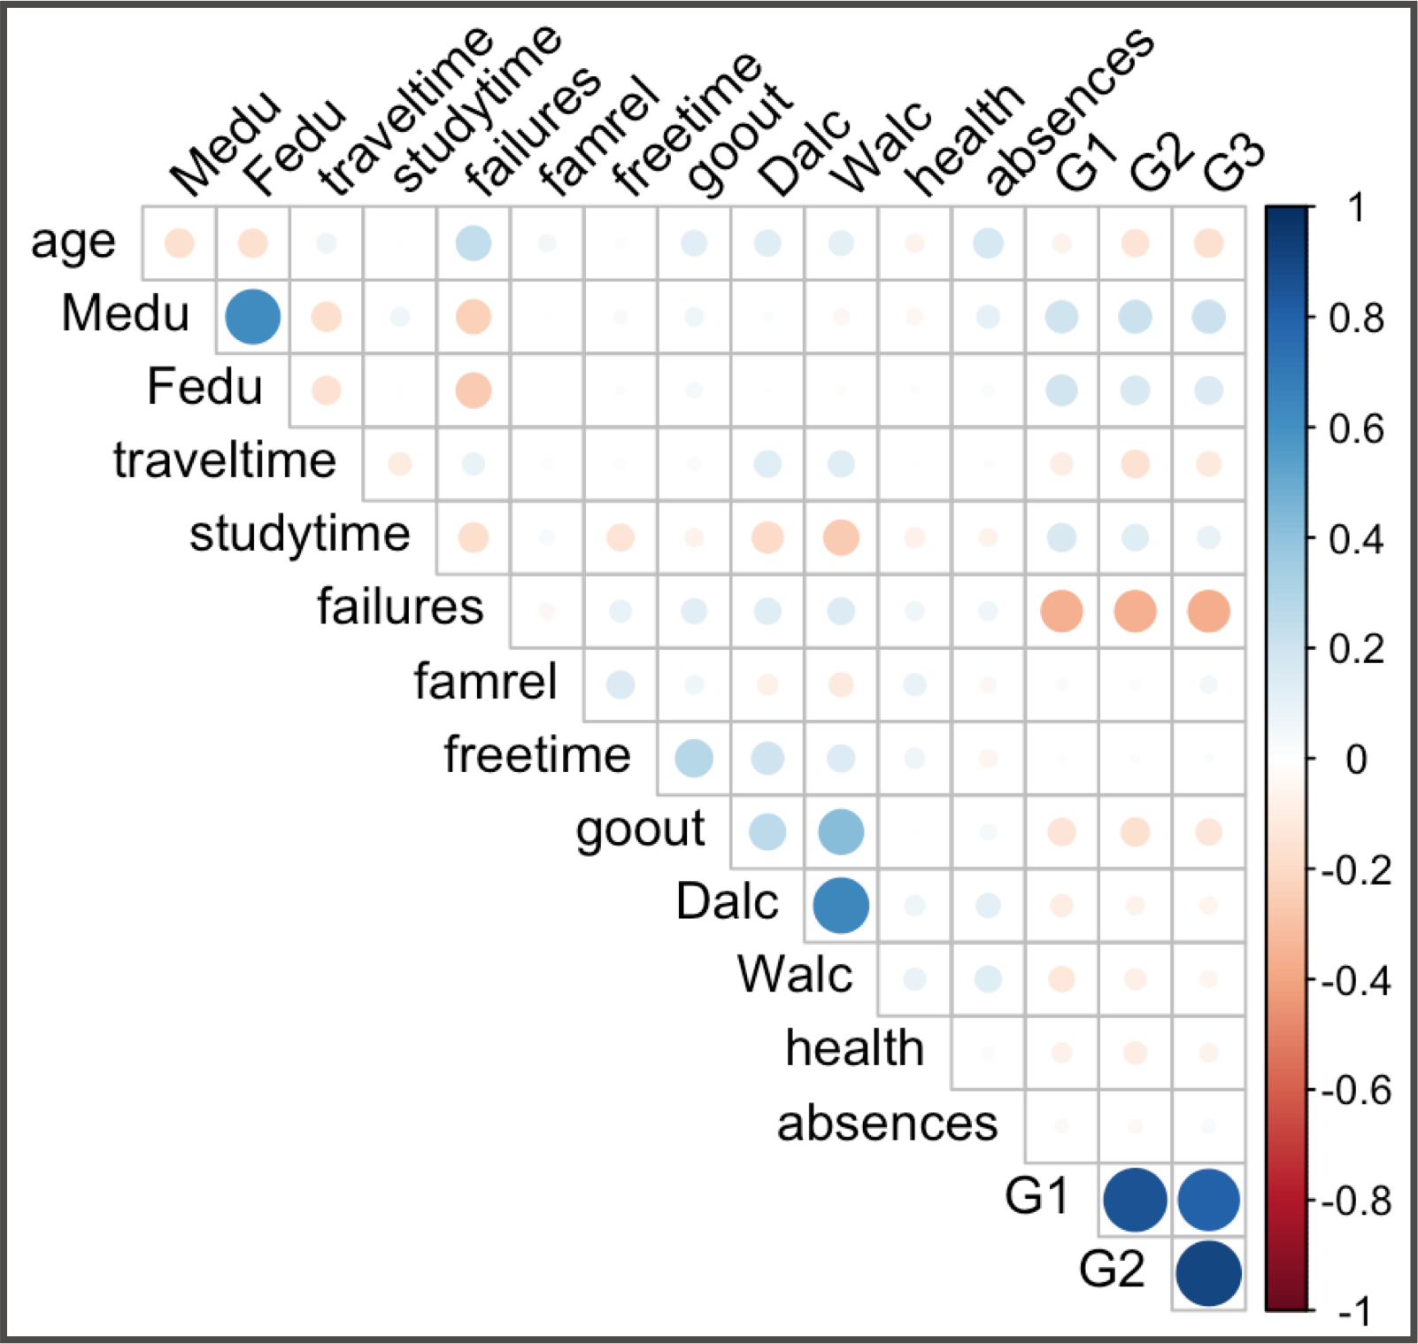
Data cleaning
We studied the correlation among quantitative variables by creating a scatterplot.
Since G1 and G2 are the grades for the first and second semester respectively, they are highly correlated with the final grade of the year G3. For this reason we have decided to remove G1 and G2.
We observed a high correlation between Medu/Fedu and decided to only keep mother education because seems to be more commonly to have a biggest impact.
For the correlation between Dalc and Walc (with is the consumption of alcohol) we solve it by computing the mean as an evaluation of the alcohol consumption on the whole week.

Slide 12
Methodology used on the Data
We will perform a multiple linear regression to build a model estimating the performance of the students (in terms of the final grade), based on its correlation (or non-correlation) with all other variables.

Slide 13
Linear regression
We used the backward elimination method and removed the variables one by one, removing the less significant variable each time (with the highest p-value greater than 0.05).
The goal is to have a model with only significant variables (p-value lower than 0.05).
The final model:
> summary(linreg)
Call:
lm(formula = G3 ~ factor(sex) + Medu + failures + factor(romantic) +
goout, data = student_data)
Residuals:
Min 1Q Median 3Q Max
-13.1385 -2.0956 0.4001 2.8171 8.6257
Coefficients:
Estimate Std. Error t value Pr(>|t|)
(Intercept) 10.6342 0.8244 12.900 < 2e-16 ***
factor(sex)M 0.9557 0.4263 2.242 0.02554 *
Medu 0.6157 0.1999 3.080 0.00221 **
failures -1.8943 0.2964 -6.391 4.72e-10 ***
factor(romantic)yes -0.9279 0.4509 -2.058 0.04028 *
goout -0.4571 0.1916 -2.386 0.01753 *
---
Signif. codes: 0 ‘***’ 0.001 ‘**’ 0.01 ‘*’ 0.05 ‘.’ 0.1 ‘ ’ 1
Residual standard error: 4.173 on 389 degrees of freedom
Multiple R-squared: 0.1807, Adjusted R-squared: 0.1702
F-statistic: 17.16 on 5 and 389 DF, p-value: 2.371e-15
linreg <- lm(G3~factor(sex) + Medu + failures
+ factor(romantic) + goout, data=student_data)
summary(linreg)
Anova test:
p-value < 5%, reject H0
The regression is globally significant

Slide 14
Linear regression
The final equation to predict G3 (the final grade year) is:
G3 = 10.63 + 0.96 sex(M) + 0.62 Medu - 1.89 failures - 0.93 romantic(yes) - 0.46 goout
The intercept is 10.63.
Meaning of the coefficients of the significant variables (all other conditions being equal):
surprisingly, males have on average higher grades of almost one unit higher than females;
the level of education of the mother (and also that of the father, as they are correlated) has a slightly positive impact on the final grade;
the most important impact on the grade is the number of examinations failed in the past: each failed exam has a negative impact of almost two units on the final grade;
being in a romantic relationship has a negative impact on the final grade of almost one unit;
the fact of going out often has a slight negative impact on the final grade.
Quality of the model:
We found a R-squared of 17,02% wich is low but can be explained by the fact that there are probably many other variables which could explain the final grade of the students.
We also have a relatively small dataset. Having more observations would give us a greater power to detect patterns or differences and thus increase our predictive power.

Slide 15
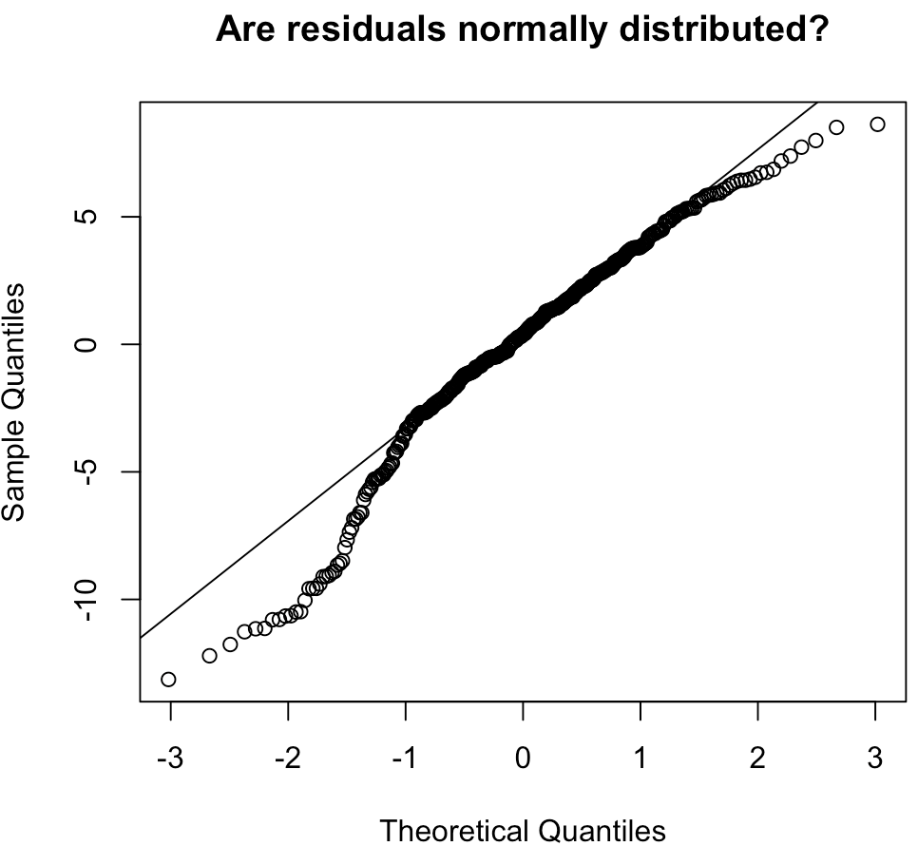
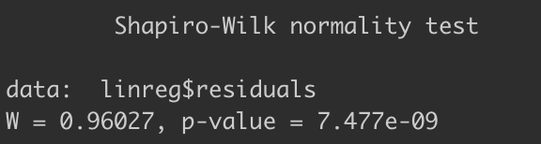
Verifying the hypotheses
res <- linreg$residuals
summary(res)
> summary(res)
Min. 1st Qu. Median Mean 3rd Qu. Max.
-13.1385 -2.0956 0.4001 0.0000 2.8171 8.6257
The mean of the residuals is equal to zero
The normality
The p-value is < 5%
We reject H0 so the residuals are not normally distributed.
The assumption of the normality of the residuals is not the most invalidating. The sample size is large enough (> 30 observations) so the results of the model remain valid, even if the assumption of normality is not verified.

Slide 16
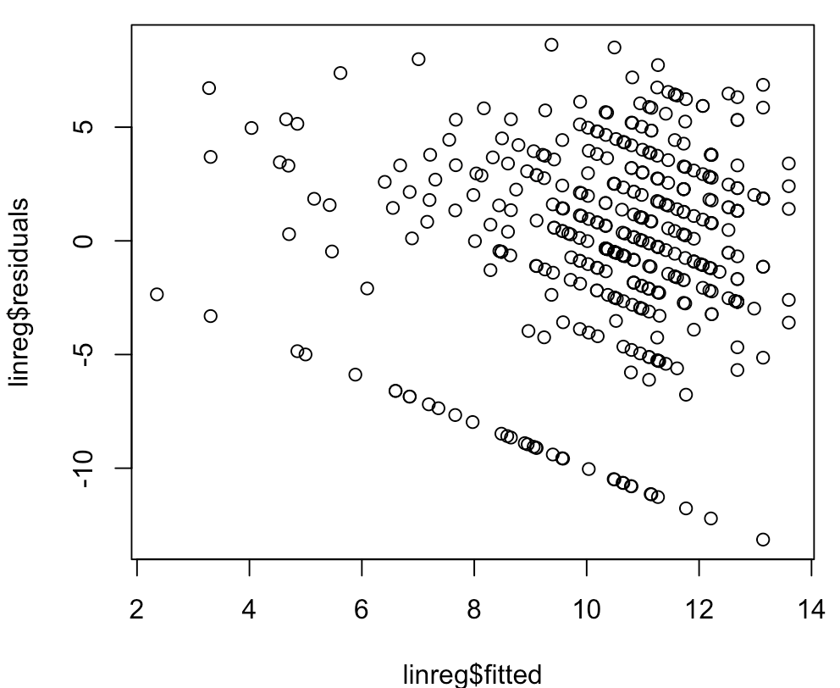
Verifying the hypotheses
> bptest(linreg,studentize=FALSE, data=data)
Breusch-Pagan test
data: linreg
BP = 5.0352, df = 5, p-value = 0.4116
P-value > 5%, we accept H0
Residuals are homoskedastic.
> durbinWatsonTest (linreg,max.lag=1)
lag Autocorrelation D-W Statistic p-value
1 -0.02873169 2.05287 0.62
Alternative hypothesis: rho != 0
Regarding the durbinWatson test there is no autocorrelation in the residuals.
P-value >5%, we accept H0
> vif(linreg)
factor(sex) Medu failures factor(romantic) goout
1.027498 1.083203 1.099091 1.026047 1.029474
All the VIFs are < 5, so there is no multicollinearity.

Slide 17
Forecasting
We used our predictive model to forecast the final grade of two different student profiles:
1- A male student, who’s mother education is equivalent to primary education, who failed 3 classes in the past, is engaged in a romantic relationship, and who often goes out with his friends [sex=M, Medu=1, failures=3, romantic=yes, goout=4]
2- A female student, who’s mother education is equivalent to secondary education, who never failed a class in the past, is not engaged in a relationship, and does not got out often with her friends [sex=F, Medu=3, failures=0, romantic=no, goout=1]
For the student 1 the predicted grade is 3.77/20, associated with the 95% confidence interval [-4.61 , 12.15]
For the student 2 the predicted grade is 12.02/20, associated with the 95% confidence interval [3.76 , 20.29]
> predict(linreg, predictors1, type="response",interval = "prediction", level = 0.95)
fit lwr upr
1 3.766192 -4.615018 12.1474
> predictors1 <- data.frame(sex='F', Medu=3, failures=0, romantic ='no',
+ goout=1)
> predict(linreg, predictors1, type="response",interval = "prediction", level = 0.95)
fit lwr upr
1 12.02425 3.756387 20.29211

Slide 18
Conclusions
As the quality of the model is low the confidence interval is quite wide and takes values outside of [0,20].
This is mainly due because of the numerous other factors we have to consider for the prediction of the performance at a final exam, such as the anxiety of the student or his/her knowledge level on the specifically evaluated subject or the luck component he/she may have during the final examination.
Still our model gives good insights on the chance of success or failure of the students regarding the different significant variables we identified.
Some of our initial assumptions have been confirmed:
- the mother's education (and in general that of both parents) has a positive impact on the student's final grade, it is likely that these parents have more chances to help their children with their homework and to motivate them to study more.
- the fact of going out a lot during the week takes time away from the study and the fact of having failed previously indicates a poor attitude to study so these two factors have a negative impact on the final grade.
Two initial assumptions have not been confirmed:
- surprisingly gender, in favour of males, is a significant factor in the student's final grade
- the fact of having a romantic relationship is a negative factor in the final grade
In addition, there are many other variables that we expected to have a positive or negative influence on the final grade, but which in the end are not in the final model, which only takes into account the most significant variables.

